Slide 1
AMES Housing Sales Price prediction
Purpose:
Predict house sale price at AMES City
Helps general public and Real estate agent
who are looking to buy or sell houses
New builders guide for their building expenses

Slide 2
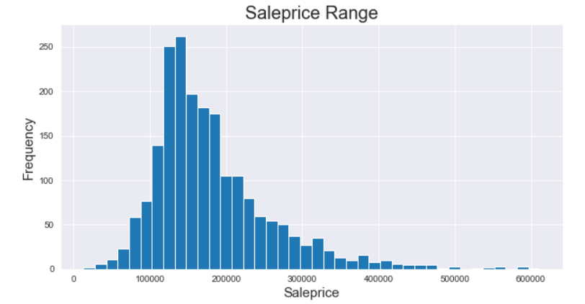
Sales Price Range - USD 12789.00- 611657.00
Maximum Sales Range - USD 70000.00 - 350000.00

Slide 3
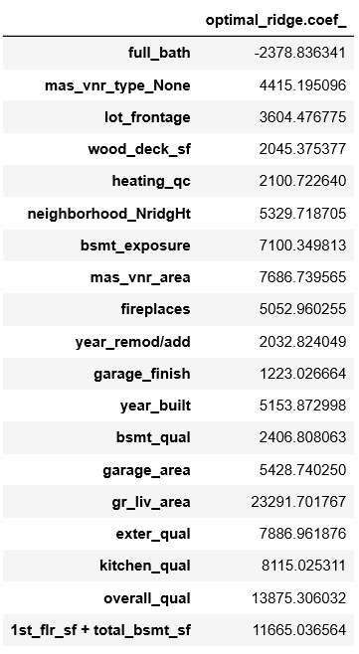
Features affecting Salesprice
Gr_liv area - high influence.
Full bath - negative influence.
Year built and area also have higher influence
Multiply coefficient by per unit increase in the features.

Slide 4
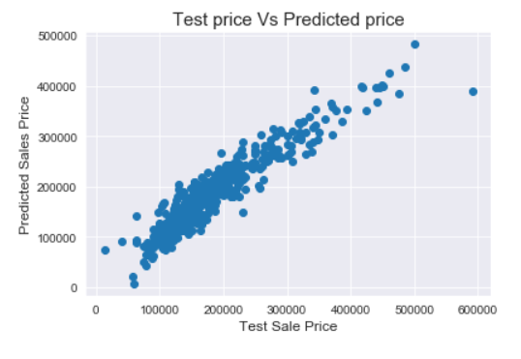
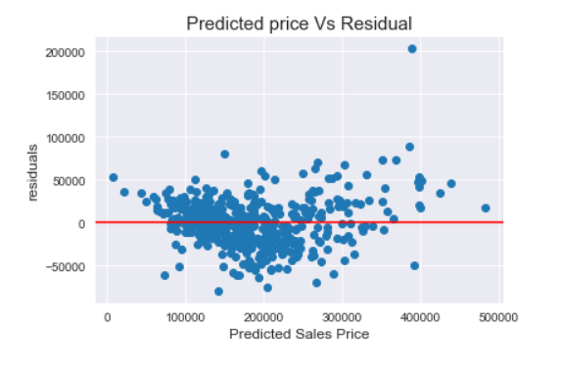
MODEL PREDICTION RANGE
Average Error = 27087.94

Slide 5
RECOMMENDATION:
Predict with an average error of 27087.94
Range within USD 500000.
This model is quite helpful as our Maximum Sales Range is USD 70000.00 - 350000.00
Thank you for watching this presentation

